Slide 1
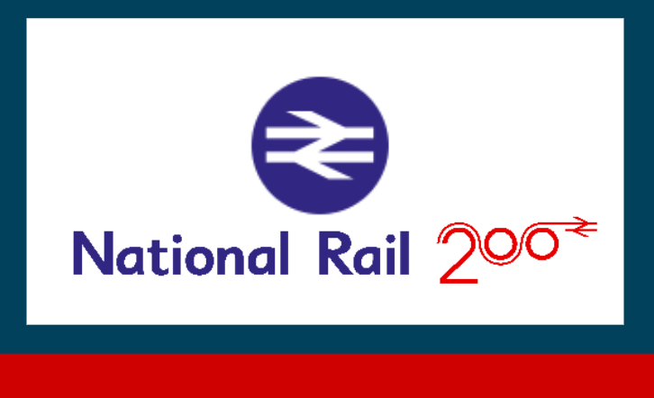
UK Train Rides Project
Supervised by Dr. Anas Ismail
Team Members
Abdel Moneim Mohamed Ashraf Ali Kareem Mostafa | Mohamed Ahmed Mohamed Elsourogi Mostafa Said El-Ashmawy

Slide 2







Content
Data Set Description
Problem Statement
Analysis Strategy
Work Stream 1 : Customer Behavior
Work Stream 2: Train Rides Operations
Work Stream 3: Revenue Analysis
Recommendations

Slide 3

Data Set Description
The dataset encompasses comprehensive information on train rides across the UK, capturing various aspects of each transaction with 18 columns and 31,654 rows enables in-depth exploration of travel patterns and service performance within the UK rail system
A
B
Key columns include the Transaction ID, which uniquely identifies each purchase, and timestamps for both the Date and Time of Purchase.
C
The Purchase Type and Payment Method detail how tickets were acquired, while the Railcard and Ticket Class provide insight into customer demographics and travel preferences.
D
Additional columns such as Price, Departure Station, and Arrival Destination reflect the journey specifics, complemented by the Date of Journey, Departure Time, and Arrival Time
E
The dataset also tracks the Actual Arrival Time, and Journey Status, allowing for analysis of punctuality, alongside the Reason for Delay and any Refund Requests submitted

Slide 4

Problem Statement
How to maximize UK railway revenue by:
Strengthening the customer loyalty,
Attract new customers, and
Reducing the number of delayed & cancelled trips.
National Rail

Slide 5
Analysis Strategy
Customer Behavior
Train Rides Operations
Revenue Analysis
Kareem Mostafa
Mohamed Elsourogi
Ashraf Ali
Mostafa Said El-Ashmawy
Abdel Moneim Mohamed
Mohamed Ahmed
Understanding customer behavior is essential for enhancing the overall travel experience.
Efficient train rides operations are critical for maintaining punctuality and customer satisfaction.
Revenue analysis plays a pivotal role in the financial health of train services.
By analyzing transaction data, including purchase types and payment methods, we can identify trends in customer preferences and tailor services accordingly.
By examining data on departure and arrival times, delays, and journey statuses, we can assess operational performance.
By scrutinizing ticket prices, sales data, and refund requests, organizations can gain insights into revenue streams and profitability.
Insights gained from this analysis can inform targeted marketing strategies and improve customer engagement.
This information helps in identifying bottlenecks and implementing improvements to ensure that services run smoothly and on time
This analysis aids in strategic decision-making, enabling operators to optimize pricing strategies and enhance overall revenue performance.

Slide 6


Work Stream 1: Customer Behavior
Transaction ID Purchase Type Payment Method Railcard Ticket Class Ticket Type Departure Station Arrival Destination Date of Journey
Data Understanding
Understand different variable types, info, and basic Analysis using Excel
Data Cleaning
Apply the routine Data Cleaning using Power BI
Checking data types, missing values, duplicates
Tools
Apply the Data Analysis using Power BI
Data transformation using Power Query
KPIs, Measures using DAX

Slide 7
Work Stream 1: Customer Behavior
Main Objectives
Identify customer behavior and patterns
How 5 items interact with each other
Quantity
Ticket Types
Purchase method
Time
Location
Main Questions
What is the quantity of tickets?
What type of tickets prefer?
How to purchase the tickets?
When prefer to purchase tickets?
Where prefer to use stations?

Slide 8
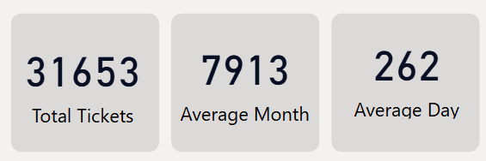
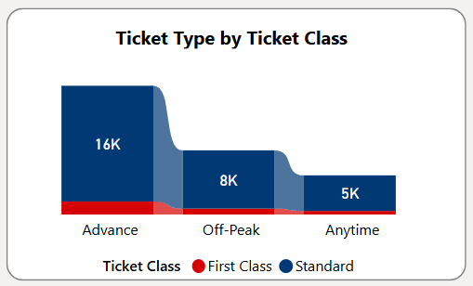
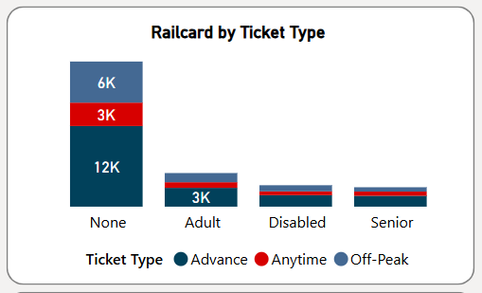
Customer Behavior Insights
Quantity
Total – Monthly -Daily
Type
Ticket type and relation with ticket class
Relation between Railcard Holder and ticket type

Slide 9
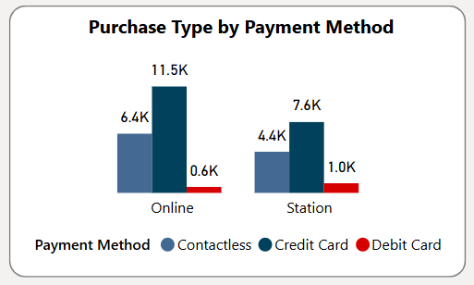
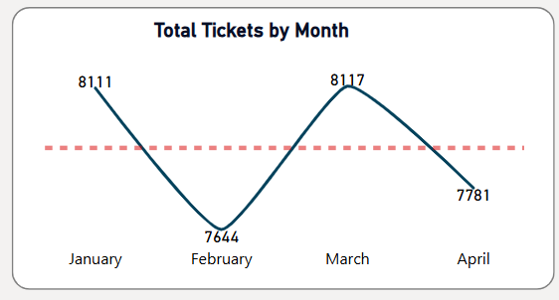
Customer Behavior Insights
Purchase Method
Relation of Purchase Type by payment Method
Time Analysis
Monthly Trend

Slide 10
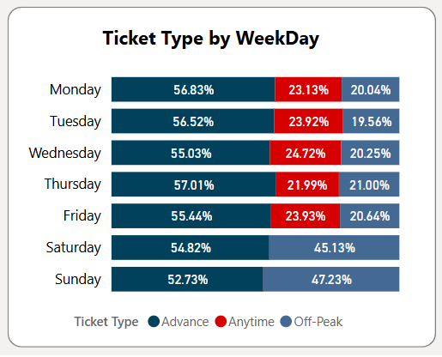
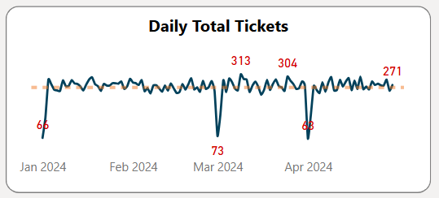
Customer Behavior Insights
Time Analysis
Week Day – Ticket Class
Interaction between weekday and Ticket class type
Daily Trend

Slide 11
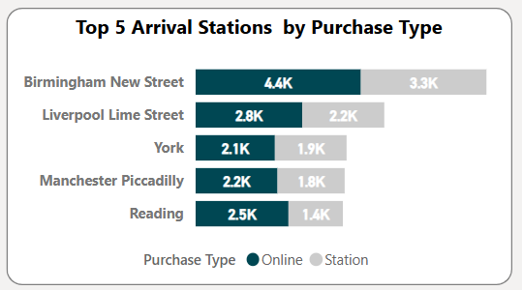
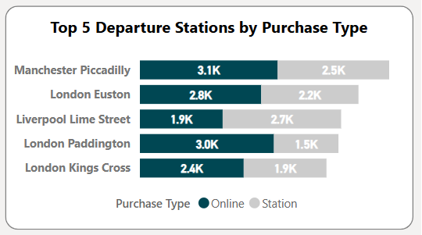
Customer Behavior Insights
Location
Top 5 Departure / Arrival Stations
Connect with purchase type

Slide 12



Work Stream 2: Train Rides Operations
Applied routine Data Cleaning
Route Delays: What are the patterns in delay times across different routes?
Temporal Delay Variation: How do delays vary by time of day or day of the week?
Delay Reasons: What are the most common reasons for delays, and how frequently do they occur?
Operational Hotspots: Are there specific times or dates with significantly higher operational issues?
Improvement Opportunities: What operational improvements can be made to reduce delays?
Capacity vs. Delay : What is the relationship between train capacity and delay occurrence?
Frequent Journeys: What are the top 5 frequent journeys?
Problematic Journeys: What are the top journeys with frequent delays and/or cancellation?

Slide 13
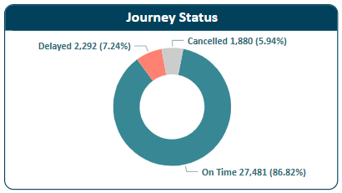


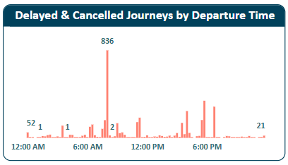


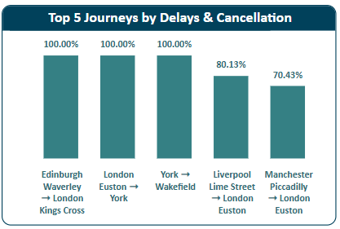
Train Rides Operations Insights
Strong Overall Reliability
The vast majority of journeys (>86%) arrived on time, indicating a generally reliable train operation
Time-Based Delay Concentration
Weekdays do not significantly influence the occurrence of delays or cancellations. However, disruptions are notably more frequent during the morning peak hours compared to the afternoon peak
Stations with Elevated Delay Rates
Liverpool Lime Street is the station most affected by delays, with Manchester Piccadilly being the second most impacted
Journeys Prone to Disruption
The ranking of problematic journeys can shift depending on the chosen metric (absolute count, ratio, or revenue impact).
Liverpool Lime Street to London Euston and Manchester Piccadilly to Liverpool Lime Street experience the highest absolute number of delays and cancellations.
When considering the ratio of delayed/cancelled journeys to total journeys, Edinburgh Waverley to London Kings Cross, London Euston to York and York to Wakefield show the highest proportion of disruptions.

Slide 14

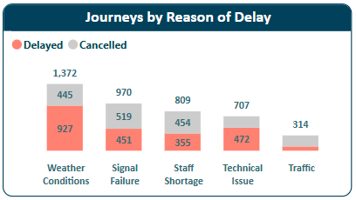

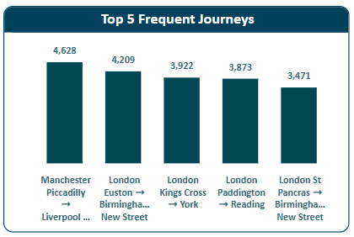


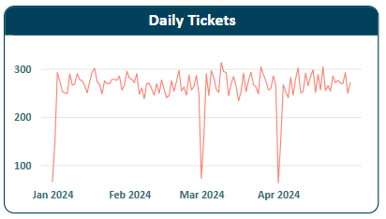

Train Rides Operations Insights
Dominant Cause of Disruption
Weather conditions are the most frequent factor leading to both delays and cancellations.
High-Impact Delay Factors
Signal issues and staff shortages, while potentially less frequent, result in the longest average delay time (approximately 52 minutes per incident).
Morning Peak Vulnerability at Liverpool Lime Street
A significant number of cancellations and delays at 8 am specifically at Liverpool Lime Street are attributed to weather conditions.
Top Travel Corridors
The five most frequently traveled routes are:
i. Manchester Piccadilly to Liverpool Lime Street
ii. London Euston to Birmingham New Street
iii. London Kings Cross to York
iv. London Paddington to Reading
v. London St Pancras to Birmingham New Street
Potential Data Inconsistencies
Analysis reveals unusual dips in daily ticket numbers during January, March, and April, suggesting potential data errors that warrant further investigation and validation.

Slide 15

Work Stream 3: Revenue Analysis
Applied routine Data Cleaning
What is the overall trend of total sales revenue?
How does revenue distribution vary across different ticket classes and ticket types?
What is the revenue contribution of Railcard holders?
Which routes generate the highest and lowest revenue? And what are the characteristics of these journeys?
How does revenue fluctuate across different months?
What is the total financial loss due to refunds?
What is the percentage of revenue lost due to refunds?
What are the primary reasons for refunds and their associated financial impact?
Is there a correlation between delays and refund requests, particularly for specific ticket types?
Can we identify any patterns or trends in refund requests over time?
How does delay time correlate with refund requests and customer satisfaction?

Slide 16
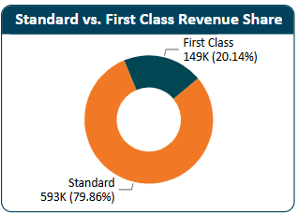


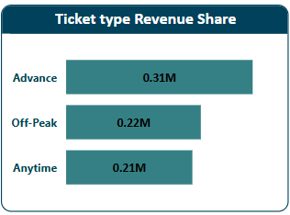

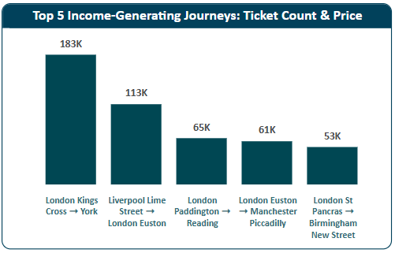
Revenue Analysis Insights
Dominance of Standard Class
Standard Class tickets contribute the majority of the revenue (79.86%) despite having a significantly lower average ticket price (£20.72) compared to First Class (£48.86). This suggests high volume in Standard Class sales
Advance Tickets Drive Volume
Advance tickets represent the largest share of revenue (41.69%), albeit with the lowest average ticket price (£17.61). This indicates a strong customer preference for discounted advance purchases
Railcard Impact
Railcard holders account for a notable portion of the revenue (22.67%), with an average ticket price (£15.67) lower than the overall average, highlighting the importance of this customer segment
Top Performing Routes
The highest revenue-generating routes are:
London Kings Cross ➝ York
Liverpool Lime Street ➝ London Euston
London Paddington ➝ Reading
London Euston ➝ Manchester Piccadilly

Slide 17

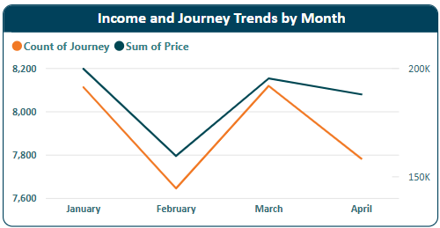

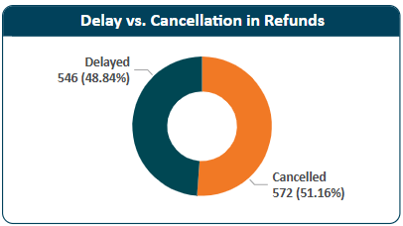


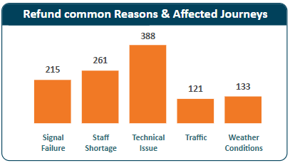
Revenue Analysis Insights
Seasonal Revenue Trends
January exhibits the highest revenue, aligning with the highest number of journeys. Conversely, February shows the lowest revenue and the fewest journeys. This suggests a strong seasonal impact on travel demand
Significant Refund Losses
The company experienced a loss of 5.22% of its total revenue due to refunds. This represents a substantial financial impact that warrants further investigation
Cancellation vs. Delay Refunds
Refunds due to cancellations (51.16% of all refunds) slightly outnumber those caused by delays
Primary Refund Drivers
The main reasons cited for refunds are technical Issue and staff Shortage
Advance Tickets and Refunds/Delays
Advance tickets appear to be more frequently associated with refund requests and are also more likely to be affected by delays. This could be due to the longer booking window and potential for disruptions.

Slide 18



Recommendations - Enhancing Revenue and Customer Engagement
Boost Advance Ticket Sales
Capitalize on Advance ticket popularity through intensified online promotions and potentially dynamic pricing strategies
Strategic Ticket Pricing Review
Evaluate the price gap between Standard and First Class to optimize revenue and potentially attract more First Class passengers
Loyalty Program for Railcard Users
Implement a loyalty program or exclusive benefits to incentivize Railcard usage and increase customer spend
Route Performance Optimization (Revenue Focus)
Review underperforming routes for pricing and marketing adjustments to improve revenue generation
External Factor Analysis (Pricing)
Utilize data on holidays and station classifications to implement a more dynamic and responsive pricing strategy
Investigate Sales Decline
Conduct a study to understand the reasons behind the observed decline in ticket sales at the beginning of each month and implement targeted strategies to mitigate it

Slide 19




Recommendations - Improving Operational Efficiency
Invest in Proactive Maintenance
Implement a robust maintenance schedule for infrastructure and trains to minimize technical issues causing delays and cancellations.
Targeted Mitigation Strategies
Develop specific strategies to address the most frequent and high-impact delay reasons
Weather: Implement robust communication protocols and alternative transportation plans for weather-related disruptions, especially at vulnerable locations like Liverpool Lime Street.
Signal Issues: Prioritize maintenance and upgrades of signaling infrastructure to minimize failures
Staff Shortage: Review staffing levels and implement strategies to ensure adequate personnel availability, particularly during peak hours
Route-Specific Performance Monitoring (Operations)
Continuously monitor top problematic routes to identify recurring operational issues and implement targeted improvements
Proactive Weather Management
Engage with meteorologists to develop predictive models for weather conditions, particularly for Liverpool Lime Street station during the 8 am peak. This will enable proactive measures to mitigate potential delays and cancellations

Slide 20



Recommendations - Enhancing Data Insights and Analysis Capabilities
Detailed Profitability Analysis
Request granular data on revenue, expenses, and operating costs per journey for deeper profitability analysis
Comprehensive Weather Data Analysis
Obtain a full year of data to accurately assess the impact of weather patterns on delays and cancellations across all seasons. The current data represents a limited timeframe.
Enhance Data Granularity (Trip Itinerary)
Incorporate trip itinerary data into future data collection efforts. This more detailed information can facilitate a deeper analysis and the identification of more granular performance indicators
Further Analysis with Capacity Data
Once train capacity data is available, conduct an analysis to understand its potential correlation with delay occurrences

